Slide 1
CablePro
Cable TV Management System
A Progressive Web App for Cable TV Operators in India
Next.js 14 · React 18 · Firebase · TypeScript · Tailwind CSS v4

Slide 2
Abstract
CablePro is a purpose-built, web-based Cable TV Management System designed specifically for local cable TV operators in India. The cable television industry serves millions of households across the country, and with rapid government-mandated digitization, operators face increasing complexity in managing subscriber data, payment collections, and regulatory compliance.
Cable Operators
Target Users
PWA / Web App
Platform
localStorage
This modern, mobile-first Progressive Web App (PWA) replaces manual registers and spreadsheets with centralized subscriber management, automatic outstanding calculations, real-time payment analytics, and secure cloud backup to Google Drive — accessible from any device, anywhere.
Primary Storage
Firebase Auth
Authentication

Slide 3
Introduction
What is CablePro?
CablePro is a centralized, web-based platform enabling cable TV operators to manage all aspects of their business — from adding subscribers to tracking monthly payments and generating financial reports.
Mobile-First
Cloud Backup
Built as a Progressive Web App (PWA), it works seamlessly on smartphones, tablets, and desktops, giving operators real-time access in the field. Designed for field use on smartphones.
Google Drive integration for data safety and secure cloud backup and recovery.
Secure Auth
Real-Time Analytics
Firebase Authentication with Google OAuth sign-in for secure access.
Dashboard KPIs and visual charts for instant business insights.

Slide 4
Objectives of the Project
01
02
Centralized Subscriber Management
Automated Outstanding Calculation
Single platform for complete customer information including STB number, plan details, and subscription status tracking.
Auto-calculate dues per subscriber based on plan type and payment history, eliminating manual errors.
03
04
Payment Tracking & Analytics
Financial Reporting
Record cash and UPI transactions with real-time visual charts showing collection trends and payment methods.
Generate PDF and CSV reports for daily, weekly, and monthly collections with custom date ranges.
05
06
Mobile-First Design
Cloud Data Backup
Flawless mobile experience optimized for field payment collection on smartphones and tablets.
Google Drive backup with configurable auto-frequency for data protection and disaster recovery.

Slide 5
Scope of the Project
1
2
User Authentication
Customer Management
Email/Password login, Google OAuth integration, profile management, and 7-day grace period for account deletion.
Full lifecycle management: add, edit, soft-delete customers with STB tracking, plan duration (1/3/6/12 months), and status filters.
3
4
Payment Management
Financial Reporting
Record cash and UPI transactions, track today/weekly/monthly totals, and prevent duplicate billing cycles automatically.
Generate reports for month or custom date ranges, analyze collection trends, and export to CSV and PDF formats.
5
6
Dashboard Analytics
Backup & Import/Export
Live KPI cards showing total customers, active subscribers, outstanding amounts, and paid collections with bar and pie charts.
Google Drive backup (manual or automatic) plus CSV import/export for bulk data migration and recovery.

Slide 6
Existing System — Limitations
Traditional methods used by cable operators create operational challenges and business risks:
Paper-Based Register
Spreadsheet (Excel/Sheets)
Proprietary Software
Data loss risk from fire or water damage
No STB or plan duration tracking
Manual page-by-page search required
No automatic outstanding calculation
Cannot access remotely
Error-prone manual recording
Complex manual formula setup
Poor mobile experience
No authentication or access control
Manual file transfer required
Requires dedicated hardware
High cost — up to ₹50,000 per year
Not mobile-optimized
Poor cloud integration
Rigid system, hard to customize

Slide 7
Proposed System — CablePro
CablePro addresses all limitations of existing systems with modern, purpose-built features:
Feature
Existing System
CablePro ✓
Access
Single location/device
Any device, anywhere
Mobile Support
None / Poor
Fully mobile-optimized
Outstanding
Manual calculation
Auto-calculated
Search
Manual scanning
Instant — name/phone/STB
Reporting
Manual summarization
Automated + PDF/CSV export
Backup
None
Google Drive cloud backup
Cost
₹0 – ₹50,000/yr
Few thousand rupees per year

Slide 8
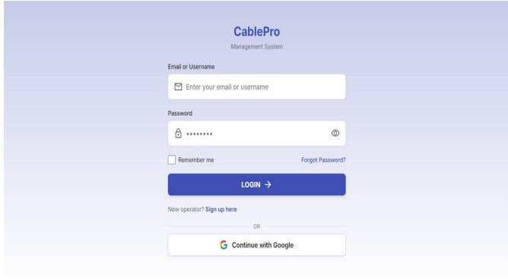
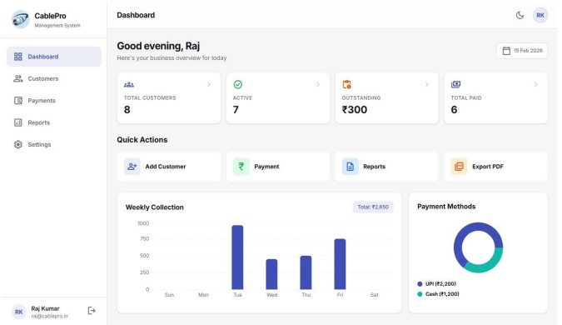
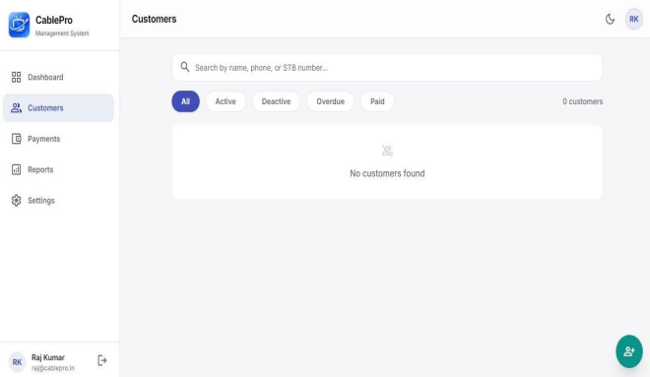
Screenshots — Core Screens
Login Page
Dashboard
Customers Page
Gradient background with email/password fields, Remember Me option, Forgot Password link, and Google Sign-In button.
KPI cards showing Total, Active, Outstanding, and Paid customers with weekly bar chart and payment methods donut chart.
Search by name, phone, or STB number. Full customer list with status badges and action buttons.

Slide 9
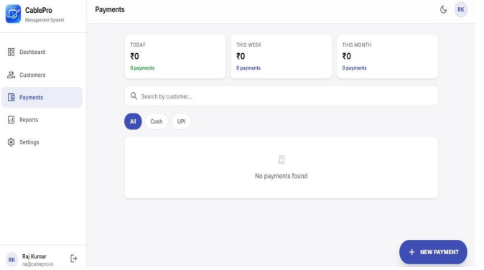
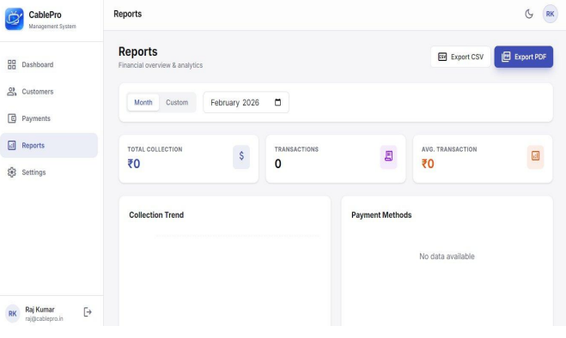
Screenshots — Payments & Reports
Payments Page
Reports Page
Today/Week/Month/Total collection cards. Searchable transactions by customer or payment method (Cash/UPI), status badges, and action buttons.
Month or custom date range filter, KPI cards, Collection Trend chart, Payment Methods breakdown, Daily Breakdown table — exportable to CSV and PDF.

Slide 10




Conclusion
CablePro Successfully Addresses Real Operational Challenges
Subscriber Management
Smart Payments
Complete lifecycle management with STB tracking and automatic outstanding balance calculation.
Duplicate-proof payment module with multi-month billing cycle logic and real-time tracking.
Mobile-First PWA
Secure & Reliable
Works offline with localStorage — accessible from any device, anywhere, even without internet.
Firebase Authentication and Google Drive backup — zero hardware cost, enterprise-grade security.
Built with: Next.js 14 · React 18 · TypeScript · Firebase · Tailwind CSS v4 · Vercel

